Slide 1
Content
1- Part I: Java Script (fundamental)
2- Part II: Install Playwright
3- Part III: Locate Elements with Playwright
4- Execute Actions on Elements with Playwright
5- Perform Test Assertions
6- Demo

Slide 2
Part I - Java Script
1- Variables and Constants
2- Promises and Async/Await
3- Control Flow
4- Error Handling
5- Functions
6- Module management

Slide 3
1.1 Java Script - Variables and Constants
Use let and const to declare variables and constants
const userName = 'admin';
const password = 'devLab08@’;
const url = 'http://example.com';
let counter = 0;

Slide 4
1.2 Java Script - Promises and Async/Await
Understand how to work with promises and use async/await for asynchronous operations.
Create a new promise:
async function asyncOperation() {
try {
const result = await myPromise;
console.log(result); // 'Operation was successful!'
} catch (error) {
console.error(error); // 'Operation failed!'
} finally {
console.log('Operation completed.'); // Always executed
}
}
Use the promise:
asyncOperation();

Slide 5
1. 3 Java Script - Control Flow
Use control flow statements like if, for, while, etc.
if (condition) {
// do something
} else {
// do something else
}
for (let i = 0; i < 10; i++) {
console.log(i);
}

Slide 6
1.4 Java Script - Error Handling
Handle errors using try/catch
try {
await someAsyncFunction();
} catch (error) {
console.error('An error occurred:', error);
}

Slide 7
1.5 Java Script - Functions
Define and use functions, including async functions for handling asynchronous operations. Functions are module and reuse codes.
async function {Name}(page) {
// login logic
}
For example:
async function login(page) {
const userName = 'admin';
const password = 'devLab08@';
const url ='http://localhost:8000/Util/Login?ReturnUrl=/en/'
// Navigate to the login page
await page.goto(url);
await page.fill('#UserName', userName);
await page.fill('#Password', password);
await page.click('#Submit');
// Wait for a post-login element to appear to ensure login is successful
await page.waitForSelector('#epi-quickNavigator-clickHandler');
}

Slide 8
1.6 Java Script – Module management
1- Export each function
use keyword “export” before of function name (If you are using an environment that supports ES6 modules)
For example: export async function gotoAdminPage(page)
2- Export multiple functions
Use module.exports = { function 1, function 2…}
For example:
module.exports = { login, gotoAdminPage, gotoEditmode, gotoForms };
Note: Java Script is case-sensitive.

Slide 9
Playwright – full example part 1
const { chromium } = require('playwright');
const { expect } = require('@playwright/test');
(async () => {
// Launch browser
const browser = await chromium.launch({ headless: false });
const context = await browser.newContext();
const page = await context.newPage();
// Navigate to the login page
await page.goto('http://localhost:8000/Util/Login?ReturnUrl=/en/');
// Perform login
await page.fill('#UserName', 'admin');
await page.fill('#Password', 'devLab08@');

Slide 10
Playwright – full example part 2
await page.click('#Submit');
// Wait for the quick navigator element to appear
await page.waitForSelector('#epi-quickNavigator-clickHandler');
// Click on the navigator and go to CMS Edit
await page.click('#epi-quickNavigator-clickHandler');
await page.click('text=CMS Edit');
// Verify elements on the CMS Admin page
await page.waitForSelector('text=Optimizely');
await page.waitForSelector('text=CMS');
})();

Slide 11

Part II – Install Playwright
Step 1: Prerequisites
Node.js: Ensure you have Node.js installed. You can download it from Node.js official website (https://nodejs.org/en).
Verify the installation by running:
node -v
npm -v
Step 2: Initialize a New Node.js Project
Create a new directory for your project (if you don't already have one):
mkdir my-playwright-project
cd my-playwright-project
Initialize a new Node.js project:
npm init -y

Slide 12
Part II – Install Playwright
Step 3: Install Playwright
npm install @playwright/test
Step 4: Install Playwright Test Runner to view the report
npm install -D @playwright/test
Step 5: Config Playwright Test Runner
create file playwright.config.js in your project folder, the content as below
// playwright.config.js
module.exports = {
reporter: 'html', // Use reporter HTML to create report
use: {
browserName: 'chromium', // Choose the browser that you want
},
};:

Slide 13

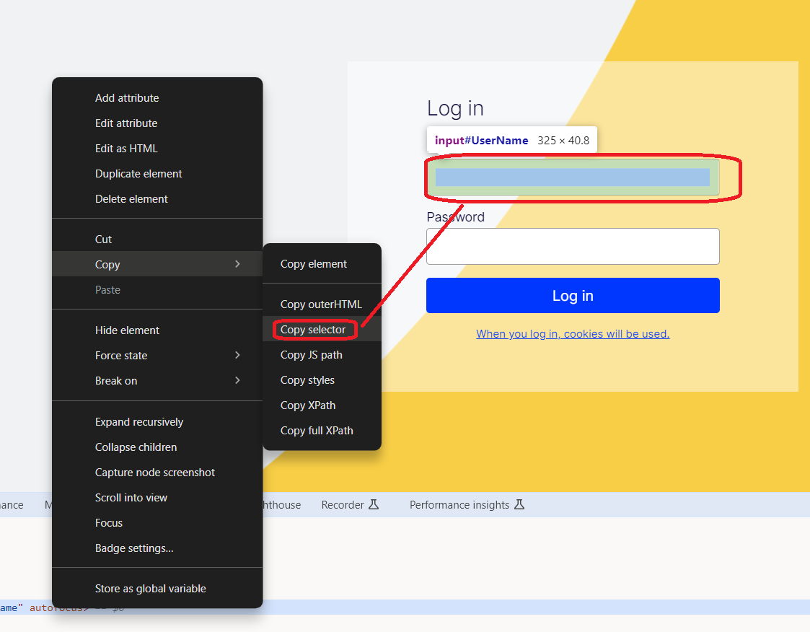
Part III: Locate Elements with Playwright
Use CSS Selectors:
1.1 querySelector: Selects the first element that matches the CSS selector
const element = await page.$('selector’);
For example
const usernameInput = await page.$('#UserName');
await usernameInput.fill(userName);

Slide 14
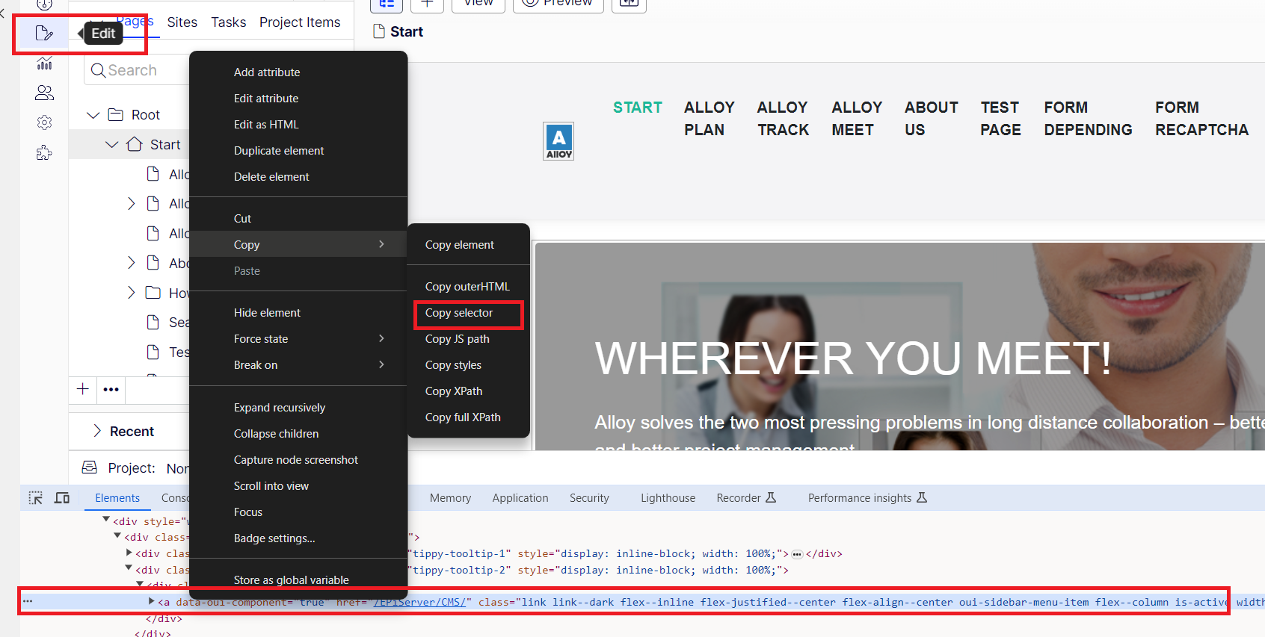
Part III: Locate Elements with Playwright
Use CSS Selectors:
1.2 querySelector: Selects all elements that matches the CSS selector
const elements = await page.$$('selector');
For example
// The first element is found and clicked
const elements = await page.$$('//*[@id="sideBarNavigationRoot"]//div[2]/div/a');
if (elements.length > 0) {
await elements[0].click(); // Click the first element found by the XPath
}

Slide 15
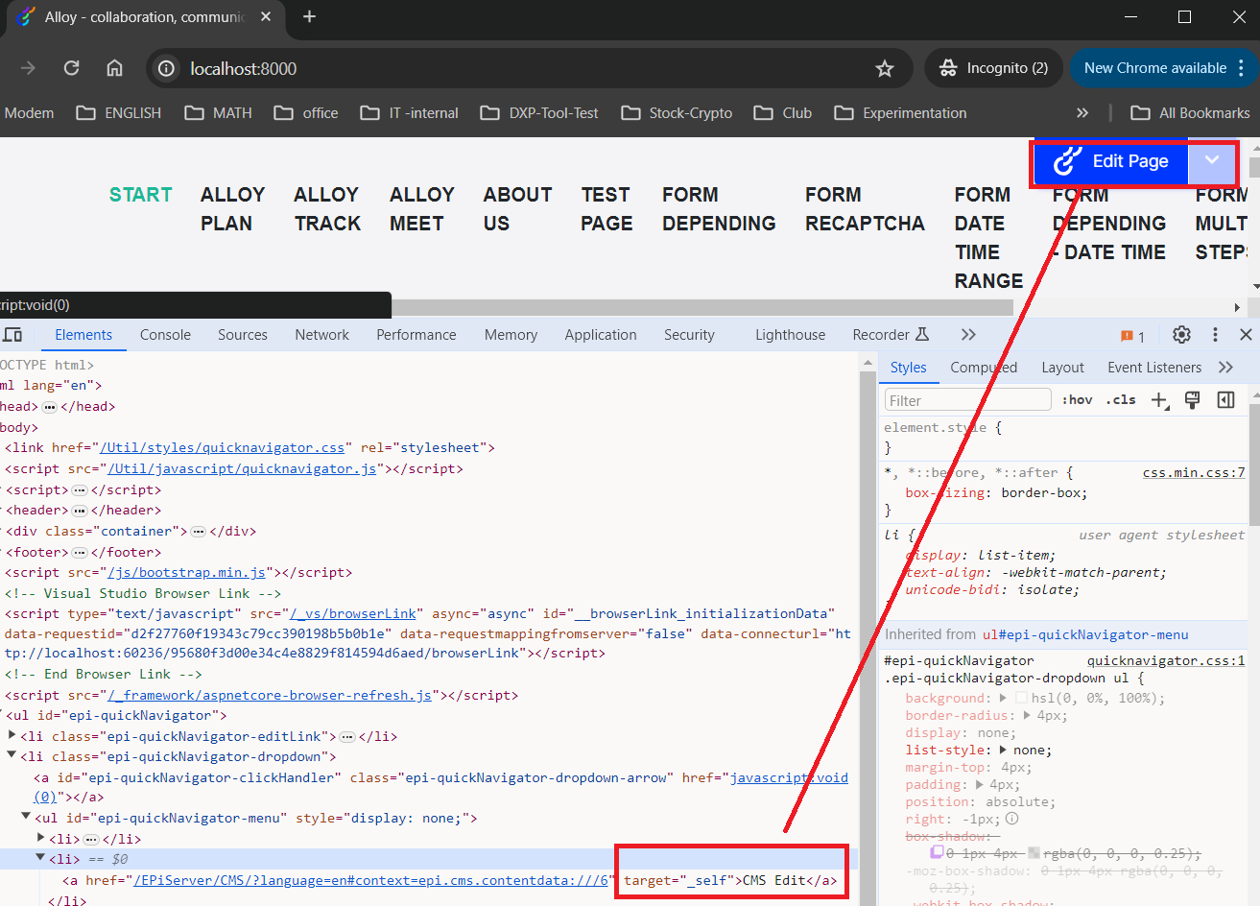
Part III: Locate Elements with Playwright
2. Use Text Content:
text: Finds an element containing the specified text.
const element = await page.getByText('Text Content');
For example
//const element = await page.getByText('CMS Edit');
//await element.click();
await page.getByText('CMS Edit').click();

Slide 16
Part III: Locate Elements with Playwright
3. Use Text Content:
text: Finds an element containing the specified text.
const element = await page.getByText('Text Content');
For example
//const element = await page.getByText('CMS Edit');
//await element.click();
await page.getByText('CMS Edit').click();

Slide 17
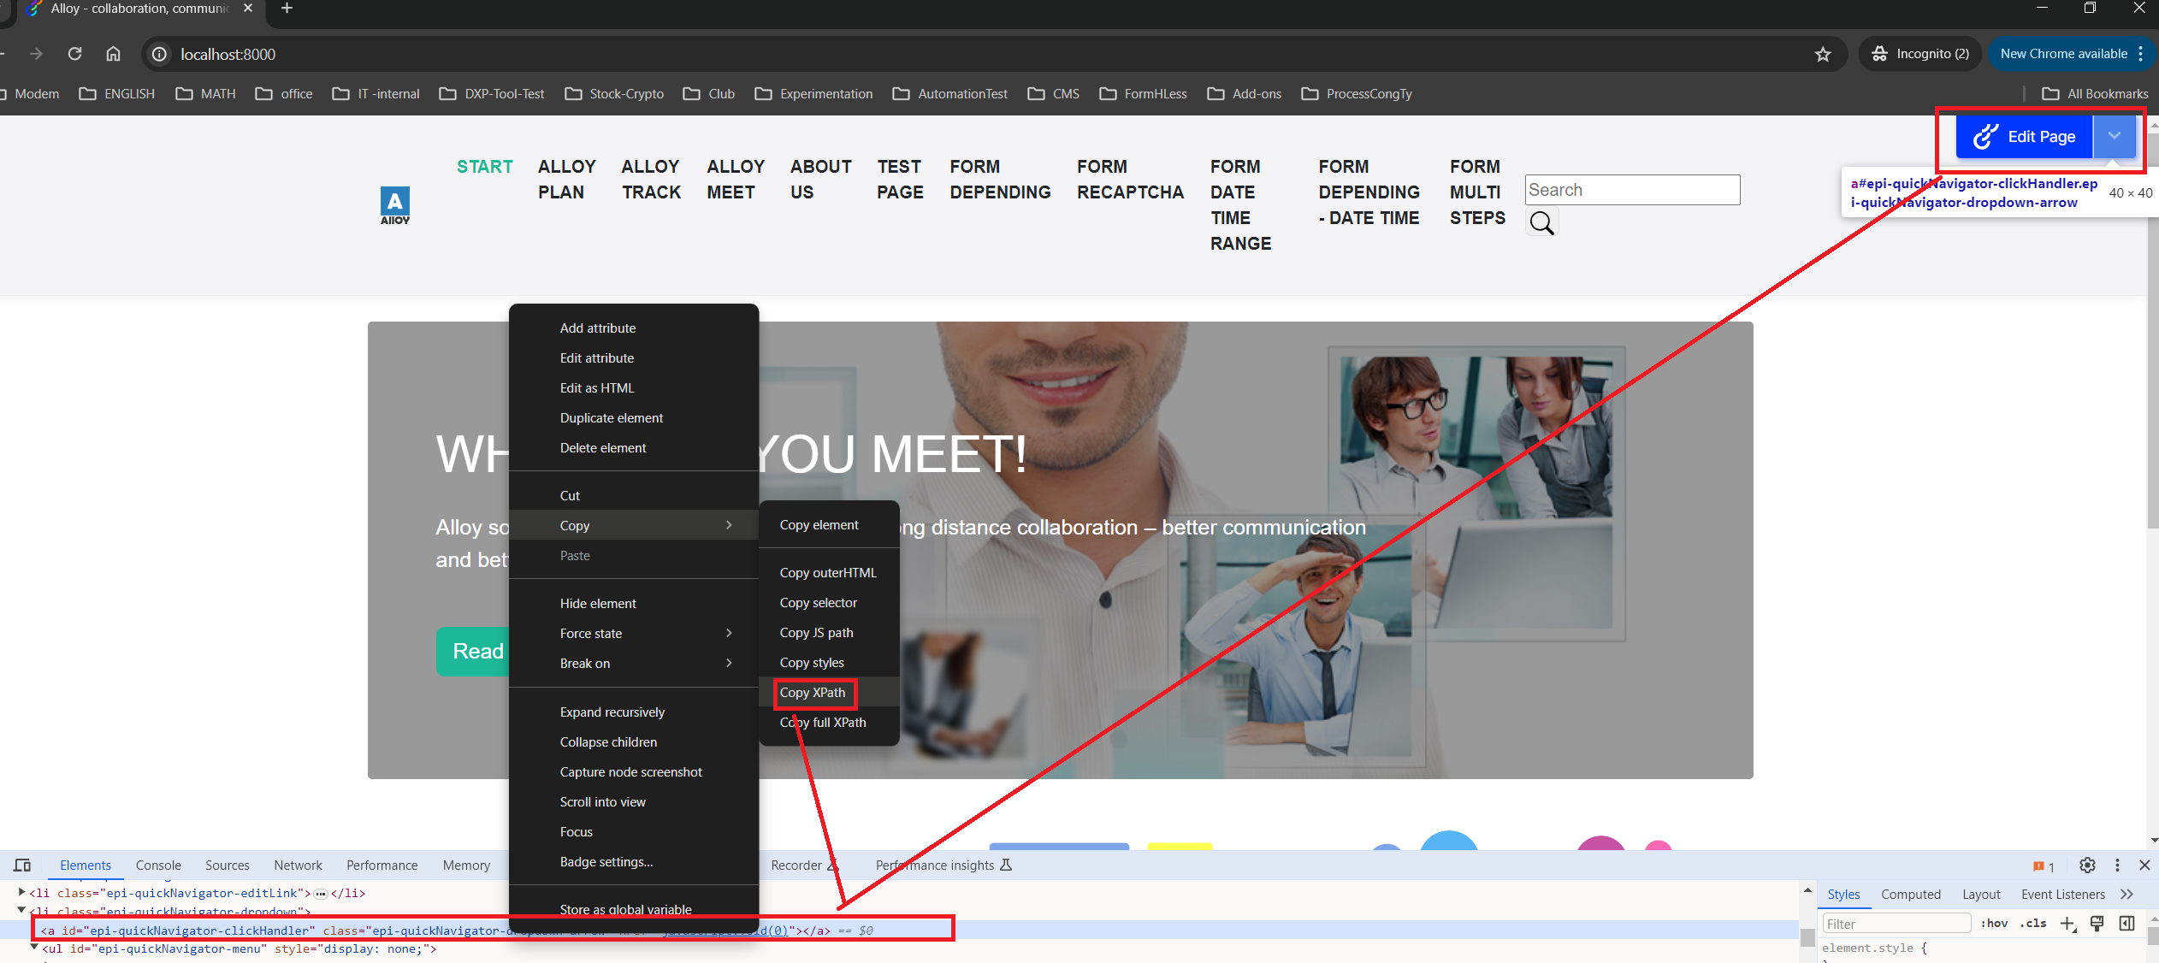
Part III: Locate Elements with Playwright
4. XPath Selectors
const element = await page.$('//xpath');
For example
// Assert Admin page
await page.$('#epi-quickNavigator-clickHandler');

Slide 18
Part IV -Actions on Elements with Playwright
Some Actions
Goto
Click
Fill
waitForSelector
…etc.

Slide 19
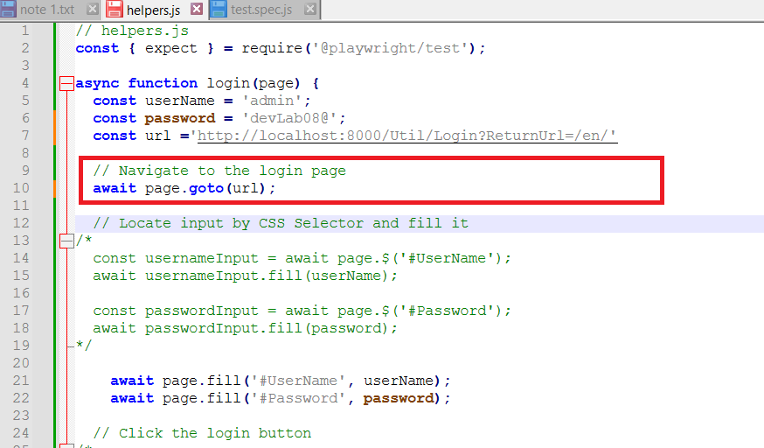
Part IV -Actions on Elements with Playwright
Goto
For example:

Slide 20
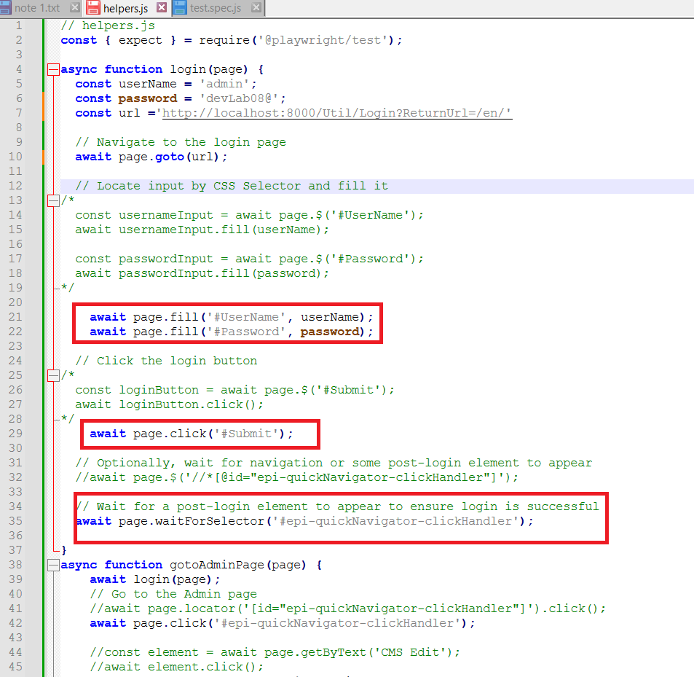
Part IV -Actions on Elements with Playwright
For example:

Slide 21
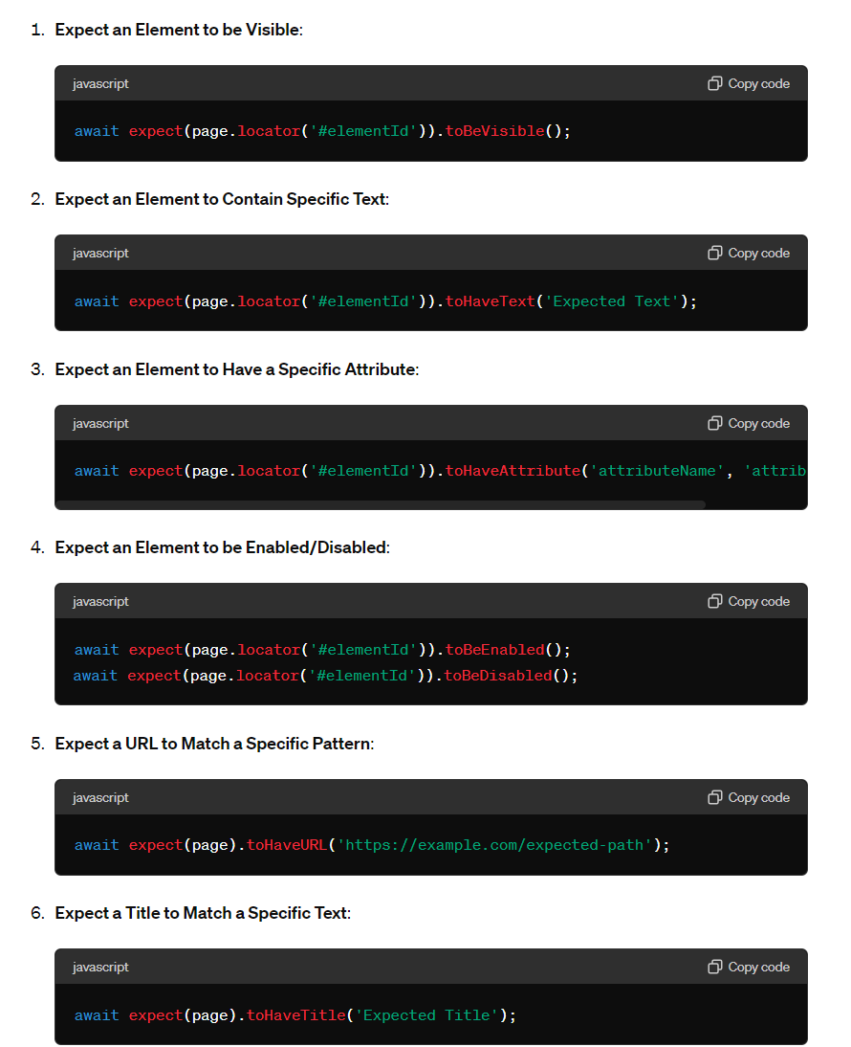
Part V - Perform Test Assertions
In Playwright, expect is used to make assertions in your tests.

Slide 22
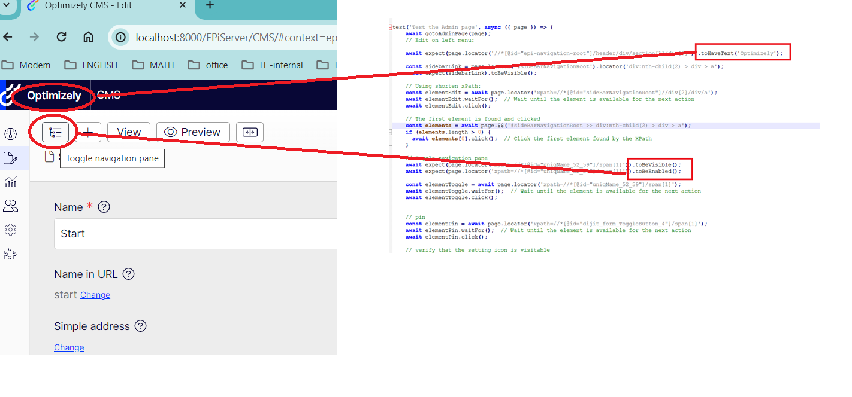
Part V - Perform Test Assertions
Practice: toBevisible, toBeEnabled, toHaveText

Slide 23
Demo &
Thank you

